Slide 2
Expectations
•You are responsible for your own learning!
•Google Drive - Access
•Self-Study – This course is very tight on time
•Student Reviews – How to make sure you are covering everything!!!
•Approaches to learning– What more can you do?

Slide 3
Course breakdown
Theory (80%)
–6 Core units 95 hrs
–5 AHL Units 60 hrs
–1 Option Unit 25 hrs Total 180 hrs
Internal assessment (20%)
–Practical work 40 hrs
–Group 4 Project 10 hrs
–Internal Assessment 10 hrs Total 60 hrs

Slide 4
It’s only a mistake if you didn't learn from it!
Assessment breakdown
Major assessments - 60%
Unit tests only
Minor assessments - 15%
quizzes, in-class tasks, etc.
Lab reports - 25%
Lab reports only

Slide 5
Science notebooks
You are to use these to take rough notes and also to complete you HW and outputs
You will then complete your student review notes to that we can be sure that you have covered every objective.
These student review notes will be handed in at the end of a unit and will be given a completion grade.

Slide 6
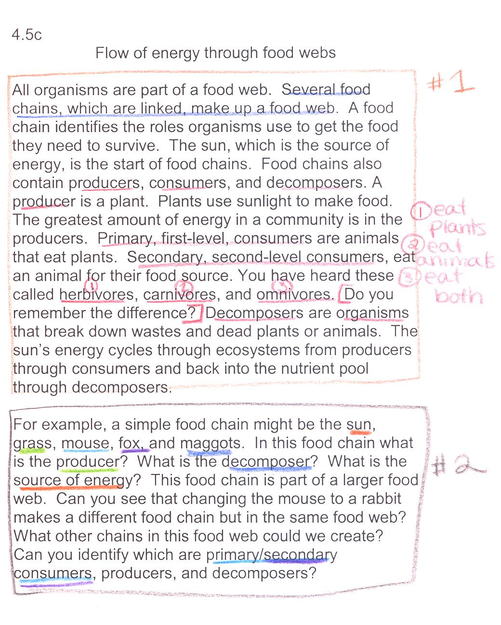
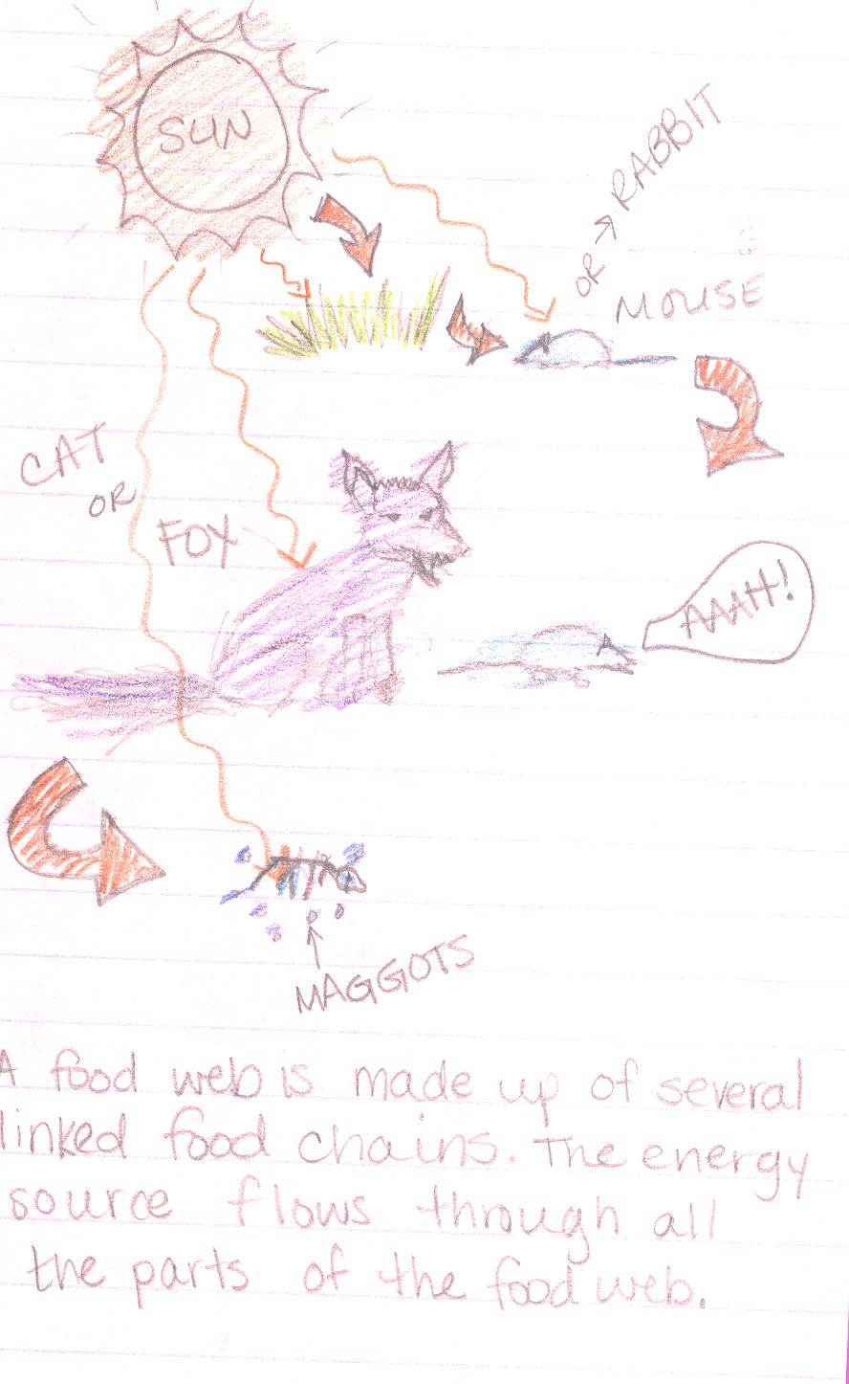
Example page:
INPUT - the information
OUTPUT - Personalised
Source: http://www.slideshare.net/arholder/interactive-science-notebook-full-version

Slide 7
Science Notebooks
A particular way of taking notes and producing an output to process your work and show your understanding in a personalised way.
1st page – Output ideas
2nd page – 1.1 Intro to cells

Slide 8
The world we live in!
Science is a way of thinking much more than it is a body of knowledge
Carl Sagan
What, why, how?
Observations are very very important

Slide 9
It’s only a mistake if you didn't learn from it!
This is your chance to shine, make the most of it!

Slide 10
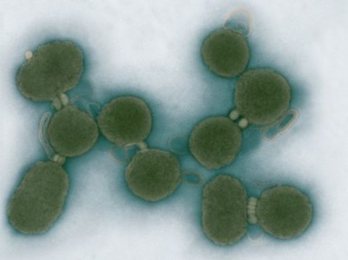
Topic 1.1 – Intro to cells
Essential idea:
The evolution of multicellular organisms allowed cell specialisation and cell replacement.

Slide 11
Understandings, Applications and skills
Follow the link and complete the form.
https://docs.google.com/a/gemsdaa.net/forms/d/e/1FAIpQLSdEzgwS35i754m7RDcGZF0o4JnFhruI5DsDXg3Fs0OwrApn0Q/viewform

Slide 12
Active listening
Connect
Extend Notes
Challenge
Be deliberate with your listening and remind yourself frequently of the objective/essential idea.

Slide 13
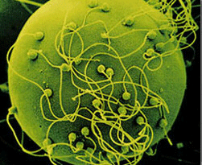
What is a cell?
The usually microscopic unit from which living things are built
A “bag” of gel-like cytoplasm inside a plasma membrane
The smallest unit capable of all the functions of life
Egg and sperm cells

Slide 14
Functions of life:
Metabolism – controls the chemical reactions of life
Reproduction – creating genetically related offspring
Homeostasis – maintaining a balanced internal environment
Growth – increase in size and mass through nutrition and metabolism
Responsiveness – changing actions or
behavior due to environmental signals
Excretion - the removal of metabolic waste
Nutrition – acquires the chemical building blocks needed to sustain life
MR H GREN

Slide 15
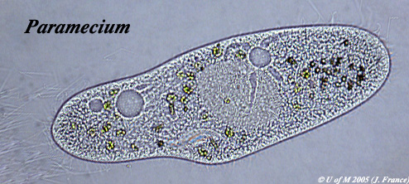
Investigation of functions of life in Paramecium and one named photosynthetic unicellular organism.
How does this paramecium show the functions of life?
Source: http://umanitoba.ca/Biology/BIOL1030/Lab1/biolab1_3.html#Ciliophora

Slide 16
Excretion – the plasma membrane control the entry and exit of substances including expulsion of metabolic waste
Homeostasis – contractile vacuole fill up with water and expel I through the plasma membrane to manage the water content
Response – the wave action of the cilia moves the paramecium in response to changes in the environment, e.g. towards food.
Metabolism – most metabolic pathways happen in the cytoplasm
Source: http://umanitoba.ca/Biology/BIOL1030/Lab1/biolab1_3.html#Ciliophora
Nutrition – food vacuoles contain organisms the parameium has consumed
Growth – after consuming and assimilating biomass from food the paramecium will get larger until it divides.
Reproduction – The nucleus can divide to support cell division by mitosis, reproduction is often asexual

Slide 17
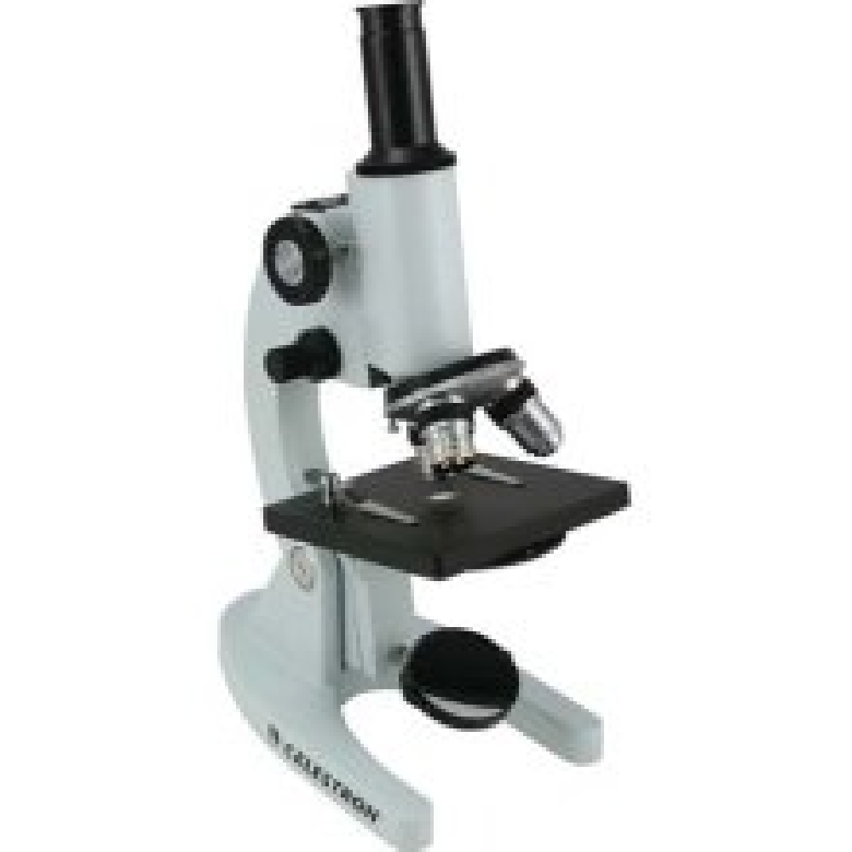
Discovery of Cells
Linked to developments in technology like the microscope
Sequence of discoveries by different scientists

Slide 18
Discovery of Cells
1590 - Jansen invents microscope
1665 - Hooke studies cork and names the structures “cells”
1675 - van Leeuwenhoek discovers unicellular organisms
1838 - Schleiden - plants are made of cells
1839 - Schwann - animals made of cells
1855 - Virchow - all cells come from cells

Slide 19
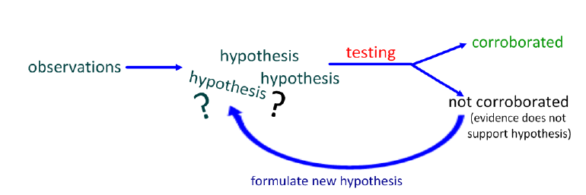
Evidence for cell theory – TOK Link
Theory - System of ideas used to explain observations

Slide 20
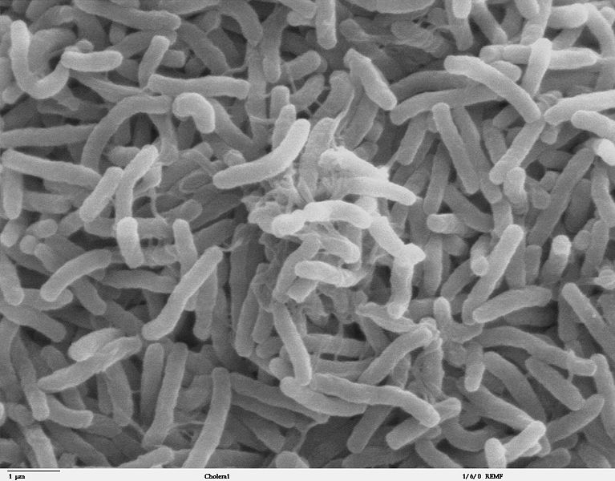
Cell Theory: first point
Living organisms are composed of cells
Evidence:
All organisms, no matter their size, are made of one or more cells.
Cholera bacteria Elephant cells
These cells all have similar chemicals and structures (membrane, ribosomes, etc.)
Notes:
‹#›

Slide 21
Nature of science:
Looking for trends and discrepancies
Although most organisms conform to cell theory, there are exceptions.

Slide 22
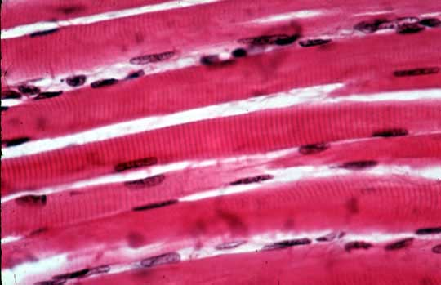
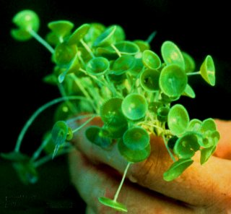
Cell Theory: first point
Living organisms are composed of cells
Challenges:
Are single-celled organisms like bacteria truly cellular?
In some fungus (aseptate fungal hyphae) and striated muscles, the cytoplasm is not separated into cells. These “cells” can be very large.
Notes:
‹#›

Slide 23
Challenge: giant algae (Acetabularia)
Acetabularia is a single-celled organism that challenges both the idea that cells must be small in size
Gigantic in size (5 – 100mm)
Complex in form, it consists of three anatomical parts:
Bottom rhizoid (that resembles a set of short roots)
Long stalk
Top umbrella of branches that may fuse into a cap
The single nucleus is located in the rhizoid
Single nuclei

Slide 24
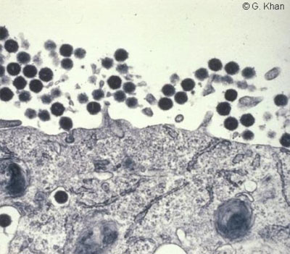
Cell theory: second point
A single cell is the smallest unit that can carry out all the functions of life
Evidence:
The cell is smallest unit known to science that can carry out all of the functions of life.

Slide 25
Cell theory: second point
A single cell is the smallest unit that can carry out all the functions of life
Challenges:
Viruses (much smaller than cells) are made of the molecules of life (like RNA or DNA) and are similar to living things, but are non-living.

Slide 26
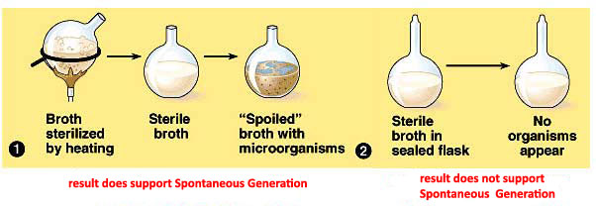
Cell theory: third point
Cells are formed only from pre-existing cells
Evidence:
When no cells are present (like in sterilized soup) no new cells can form.

Slide 27
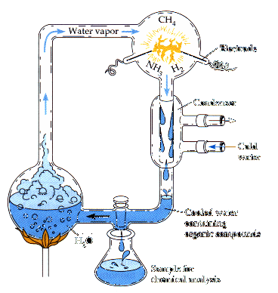
Cell theory: third point
Cells are formed only from pre-existing cells
Challenges:
Where did the first cells come from?
In a different environment, like that of the early Earth, it is thought that cells once evolved from non-living cell-like ancestors
**Endosymbiotic theory

Slide 28
Active listening
What do you think are the key concepts you should take away from todays lesson?

Slide 29
IB Objectives
According to the cell theory, living organisms are composed of cells.
Organisms consisting of only one cell carry out all functions of life in that cell.
Application: Questioning the cell theory using atypical examples, including striated muscle, giant algae and aseptate fungal hyphae.
Application: Investigation of functions of life in Paramecium and one named photosynthetic unicellular organism.

Slide 30
Essential idea:
The evolution of multicellular organisms allowed cell specialisation and cell replacement.
HW – Due next lesson
To what extent can fire be justified as living?
Create an output for cell theory
Student review notes
Applications and skills task

