Slide 1
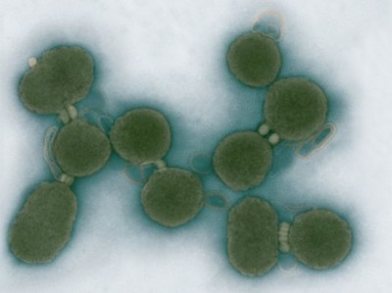
Topic 1.1 – Stem Cells and Differentiation
Essential idea:
The evolution of multicellular organisms allowed cell specialisation and cell replacement.

Slide 2
Multicellular organisms, differentiation and stem cells (TOK)
Specialized tissues can develop by cell differentiation in multicellular organisms.
Differentiation involves the expression of some genes and not others in a cell’s genome.
The capacity of stem cells to divide and differentiate along different pathways is necessary in embryonic development and also makes stem cells suitable for therapeutic uses.

Slide 3
Applications
Application: Use of stem cells to treat Stargardt’s disease and one other named condition.
Application: Ethics of the therapeutic use of stem cells from specially created embryos, from the umbilical cord blood of a new-born baby and from an adult’s own tissues.

Slide 4
Initial Bridge Task
3 thoughts or ideas about the topic
2 questions that you have
1 analogy about the topic

Slide 5
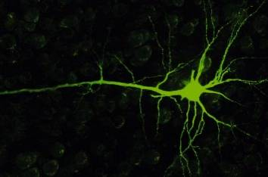
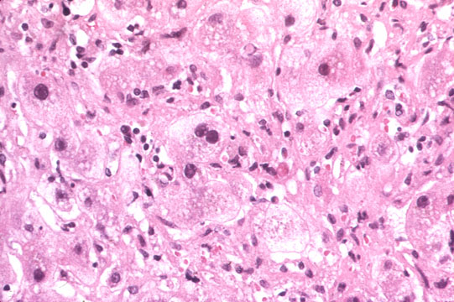
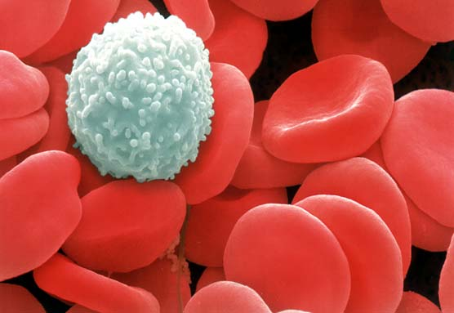
Unicellular v. Multicellular
Unicellular organisms: cells are generalists -- each cell capable of performing every life function.
Multicellular organisms: cells are specialists -- each cell is adapted to a specific, specialized function.

Slide 6
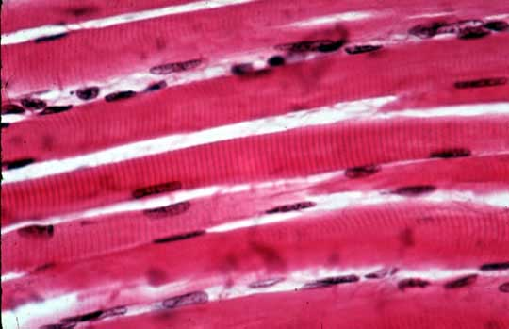
Differentiation
Every cell in a multicellular organism has the same DNA but cells develop in different ways in order to have a specialized function
Eg. Muscle cells - single function is to contract

Slide 7
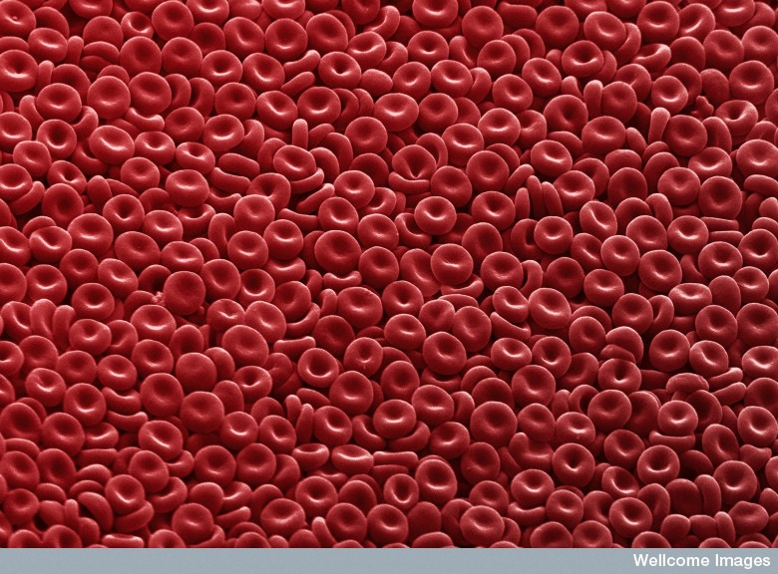
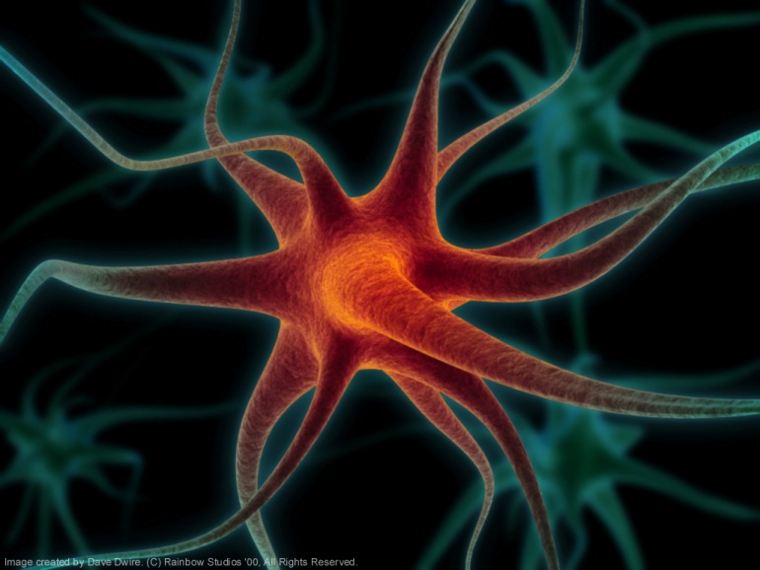
Differentiation
What do these cells do?

Slide 8
Introductory video
http://www.youtube.com/watch?v=2-3J6JGN-_Y

Slide 9
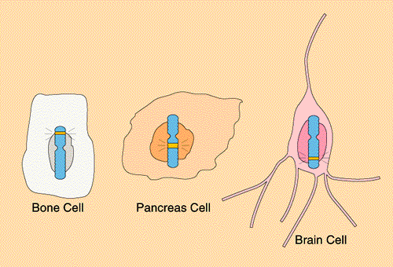
Differentiation
Once a cell specializes, it has committed and cannot change to another change to another type of cell.
All cells have the same genes but different genes are activated (turned on) or inactivated (turned off)

Slide 10
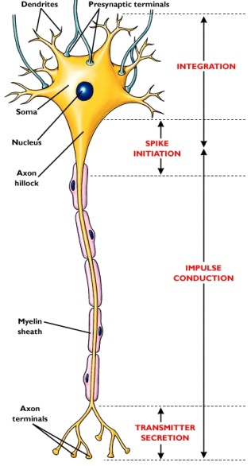
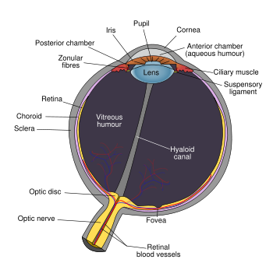
Emergent properties
When all cells in the multicellular organism work together, new abilities appear
These abilities are not found in any of the individual cells or groups of cells
Ex. Thinking, seeing

Slide 11
Stem Cells
Why is there such a fuss?

Slide 12
Ethics and Biology
Story time
Adapted from: Ted Talks

Slide 13
Nature of science:
Ethical implications of research—research involving stem cells is growing in importance and raises ethical issues.

Slide 14
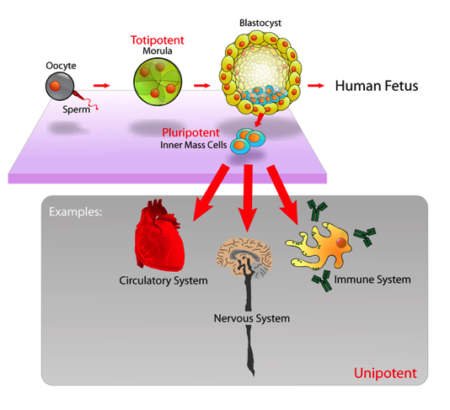
The capacity of stem cells to divide and differentiate along different pathways is necessary in embryonic development and also makes stem cells suitable for therapeutic uses.
Stem cells are unspecialised cells that can:
Can continuously divide and replicate
Have the capacity to differentiate into specialised cell types
Totipotent
Can differentiate into any type of cell.
Pluripotent
Can differentiate into many
types of cell.
Multipotent
Can differentiate into a few closely-related types of cell.
Unipotent
Can regenerate but can only differentiate into their associated cell type
(e.g. liver stem cells can only make liver cells).
Image from: http://en.wikipedia.org/wiki/Stem_cell

Slide 15
Ethics of the therapeutic use of stem cells from specially created embryos, from the umbilical cord blood of a new-born baby and from an adult’s own tissues.
 | Comparison of stem cell sources
 | Embryo | Cord blood | Adult
Ease of extraction | Can be obtained from excess embryos generated by IVF programs. | Easily obtained and stored. Though limited quantities available | Difficult to obtain as there are very few and are buried deep in tissues
Ethics of the extraction | Can only be obtained by destruction of an embryo | Umbilical cord is removed at birth and discarded whether or not stem cells are harvested | Adult patient can give permission for cells to be extracted
Growth potential | Almost unlimited | Reduced potential (compared to embryonic cells)
Tumor risk | Higher risk of development | Lower risk of development

Slide 16
Ethics of the therapeutic use of stem cells from specially created embryos, from the umbilical cord blood of a new-born baby and from an adult’s own tissues.
 | Comparison of stem cell sources
 | Embryo | Cord blood | Adult
Differentiation | Can differentiate into any cell type | Limited capacity to differentiate (without inducement only naturally divide into blood cells) | Limited capacity to differentiate (dependent on the source tissue)
Genetic damage | Less chance of genetic damage than adult cells |  | Due to accumulation of mutations through the life of the adult genetic damage can occur
Compatibility | Stem cells are not genetically identical to the patient | Fully compatible with the patient as the stem cells are genetically identical

Slide 17
Embryonic stem cells
Easier to obtain than adult stem cells
Almost unlimited growth potential (far more than adult)
Less chance of genetic damage than adult
Greater capacity of differentiate into different cell types than adult

Slide 18
Adult stem cells
No embryo needs to be destroyed
Cells are fully compatible with tissue of the adult, so no tissue rejection problems (unlike embryonic stem cells)
Less chance of malignant (cancerous) tumors developing than with embryonic stem cells

Slide 19
TOK Link
How do scientists convey information to general public
Who makes the decisions?
Are they informed?
How do we know what we know about stem cells?

Slide 20
Stem Cell Possibilities
Potential to cure many diseases
Paralysis from spinal cord injuries
Type I Diabetes
Multiple sclerosis
Parkinson’s disease
Other difficulties
Tissue rejection, cells not accepted
Cells difficult to program to differentiate into the correct type of cell

Slide 21
1.1.U7 Use of stem cells to treat Stargardt’s disease and one other named condition.
Stargardt's macular dystrophy
The problem | Affects around one in 10,000 children Recessive genetic (inherited) condition The mutation causes an active transport protein on photoreceptor cells to malfunction The photoreceptor cells degenerate the production of a dysfunctional protein that cannot perform energy transport that causes progressive, and eventually total, loss of central vision
The treatment | Embryonic stem cells are treated to divide and differntiate to become retinal cells The retinal cells are injected into the retina The retinal cells attach to the retina and become functional Central vision improves as a result of more functional retinal cells
The future | This treatment is still in at the stage of limited clinical trials, but will likely in usage in the future

Slide 22
1.1.U7 Use of stem cells to treat Stargardt’s disease and one other named condition.
Leukemia
The problem | Cancer of the blood or bone marrow, resulting in abnormally high levels of poorly-functioning white blood cells.
The treatment | Hematopoetic Stem Cells (HSCs) are harvested from bone marrow, peripheral blood or umbilical cord blood Chemotherapy and radiotherapy used to destroy the diseased white blood cells New white blood cells need to be replaced with healthy cells. HSCs are transplanted back into the bone marrow HSCs differentiate to form new healthy white blood cells
The benefit | The use of a patient’s own HSCs means there is far less risk of immune rejection than with a traditional bone marrow transplant.

Slide 23
Ethics
Most usable stem cells are from embryos
Using early-stage embryos sometimes from aborted embryos
Harm vs help decrease the suffering of patients
Culture, religion
Uncontrolled differentiation of cells into tumours

Slide 24
Ethics of the therapeutic use of stem cells from specially created embryos, from the umbilical cord blood of a new-born baby and from an adult’s own tissues.

Slide 25
Final Bridge Task
3 thoughts or ideas about the topic
2 questions that you have
1 analogy about the topic
HW- create an output that links the initial bridge activity and the final bridge activity

Slide 26
Link:
Link: Stem cells and organisms
Link: Multicellular and differentiation
Link: Can you make another one?

Slide 27
Multicellular organisms, differentiation and stem cells (TOK)
Specialized tissues can develop by cell differentiation in multicellular organisms.
Differentiation involves the expression of some genes and not others in a cell’s genome.
The capacity of stem cells to divide and differentiate along different pathways is necessary in embryonic development and also makes stem cells suitable for therapeutic uses.

