Slide 1
Circulation and Gas Exchange
Chapters 28 & 29

Slide 2
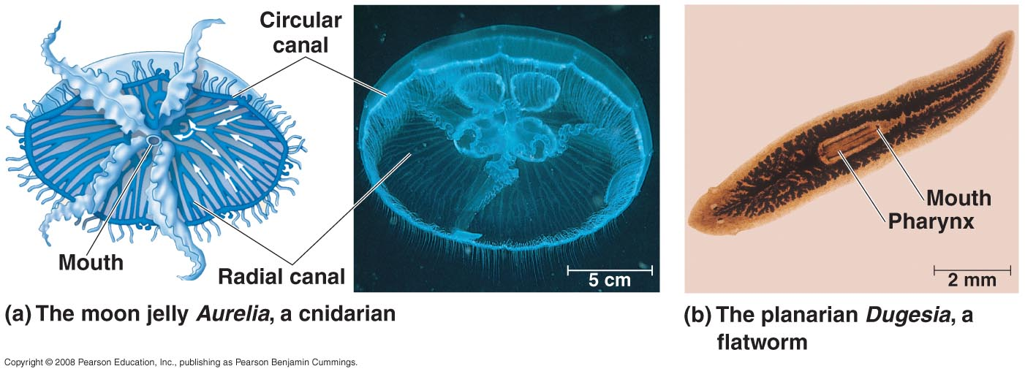
Circulatory Systems
Animals must constantly exchange materials with the environment (oxygen, carbon dioxide, etc.)
Gastrovascular cavity
Functions in digestion and distribution of substances to the body. Direct exchange to inner layer with diffusion to second layer

Slide 3
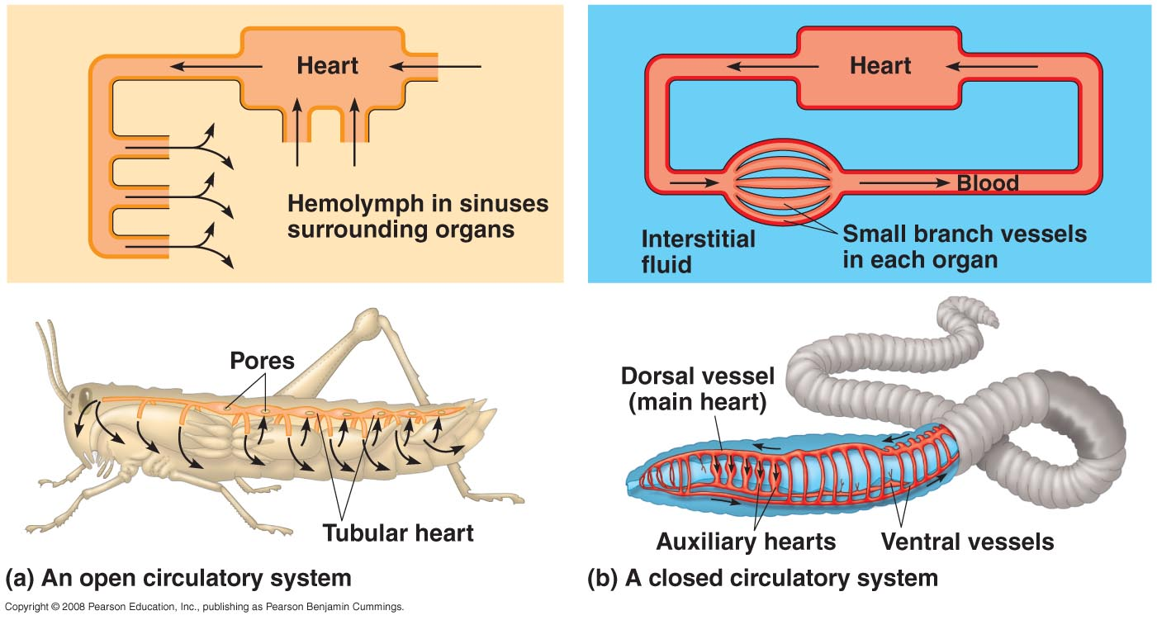
Circulatory Systems
Open circulatory system
Circulatory fluid baths the organs directly
Hemolyph is circulatory and interstitial fluid
Closed circulatory system
Blood is confined to vessels and distinct from interstitial fluid

Slide 4
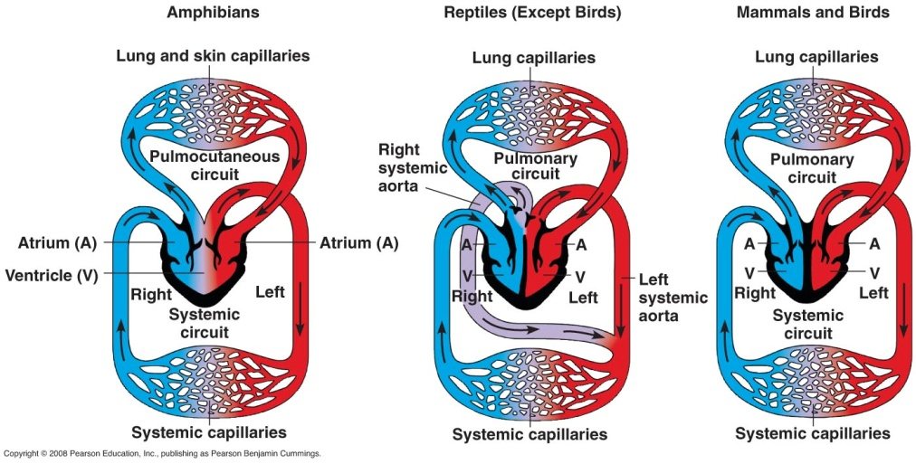
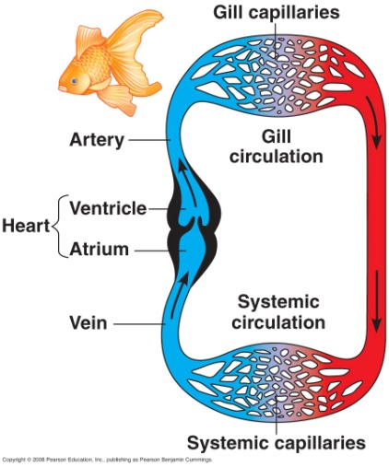
Cardiovascular Systems
Circulation in closed systems can be
Single – blood passes through the heart once in each complete circuit
Double – 2 circuits are compiled into 1 heart
Pulmonary or pulmocutaneous circuit – right side of the heart delivers oxygen-poor blood to the capillary beds in gas exchange tissues
Systemic circuit – oxygenated blood leaves the gas exchange tissue for the pump in the left side of the heart where it is propelled throughout the body

Slide 5
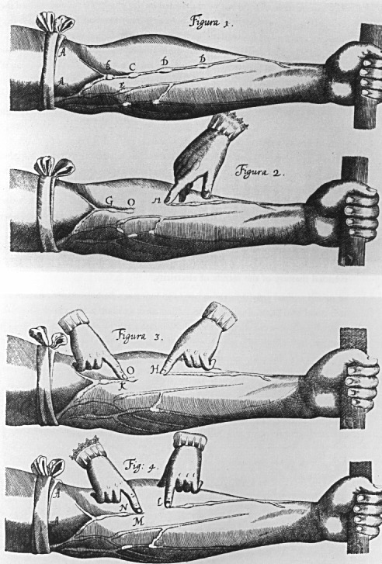
William Harvey
Proposed theory about the circulation of blood (1628)
Blood flows in both pulmonary and systemic circulations, is unidirectional and recycled by the pumping action of the heart
Predicted the existence of capillaries, linking arteries and veins (he did not see them)
Went against many of the ancient beliefs
Particularly Galen who suggested that blood formed in the liver and is pumped between the liver and the heart
www.princeton.edu

Slide 6
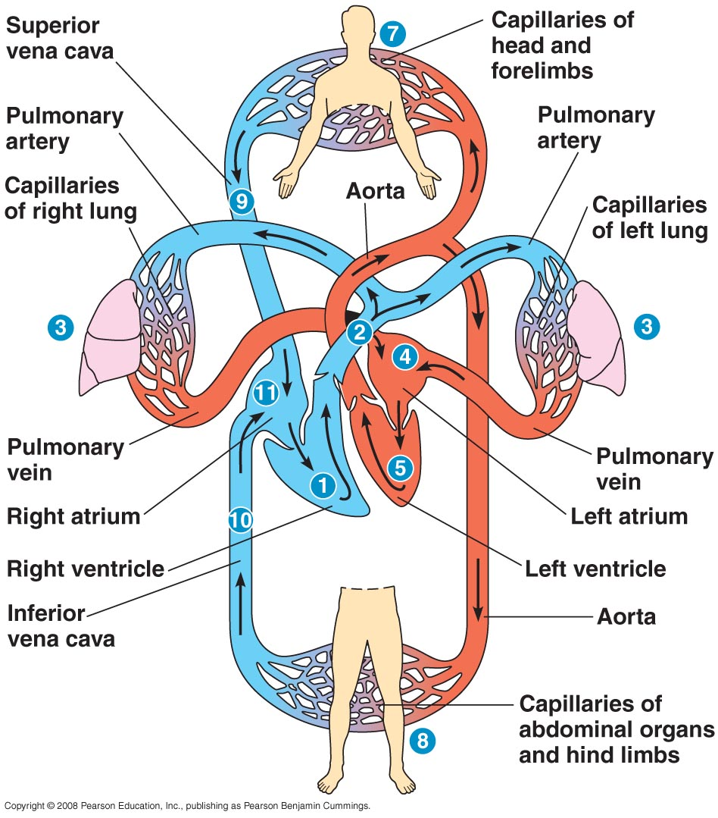
Mammalian Circulation
Contraction of the R.V. pumps blood to the capillary beds in the lungs
Blood then returns to the L.A.
The L.V. will pump the oxygenated blood out to the rest of the body via the aorta
Oxygen poor blood will return to the R.A. via the superior vena cava

Slide 7
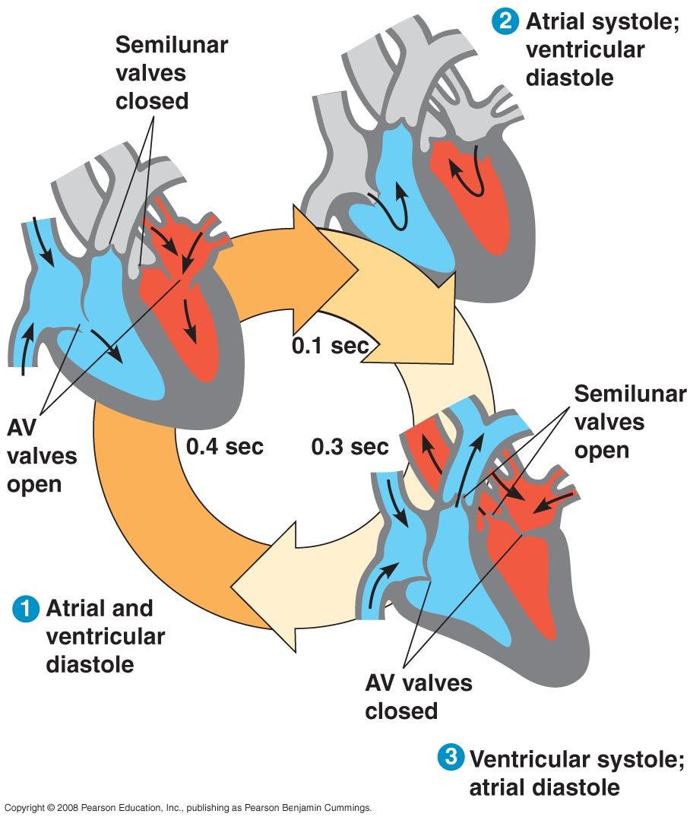
Mammalian Heart
The heart contracts and relaxes in a rhythmic cycle called the cardiac cycle
The contraction, or pumping, phase is called systole
The relaxation, or filling, phase is called diastole
Four valves prevent backflow of blood in the heart

Slide 8
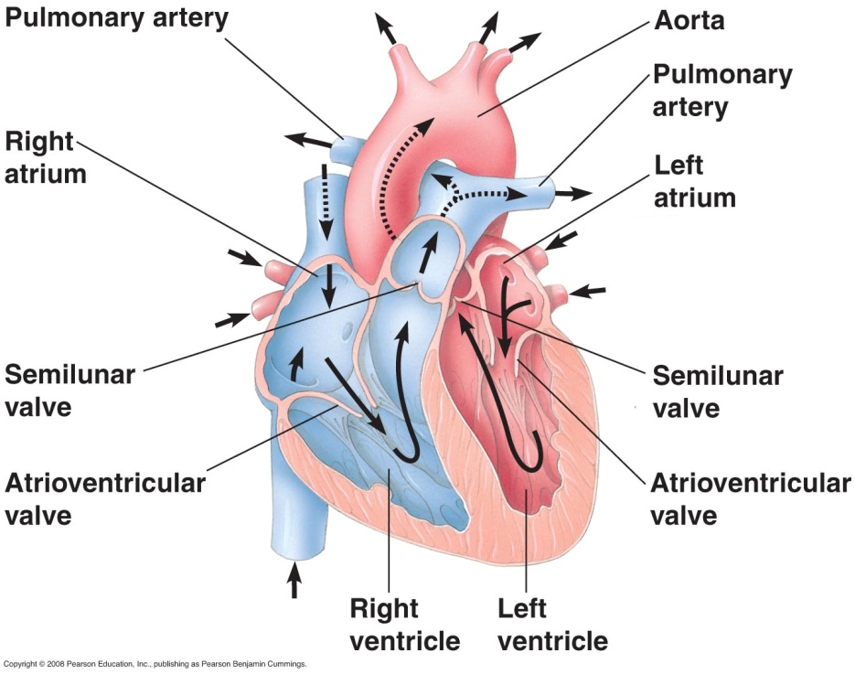
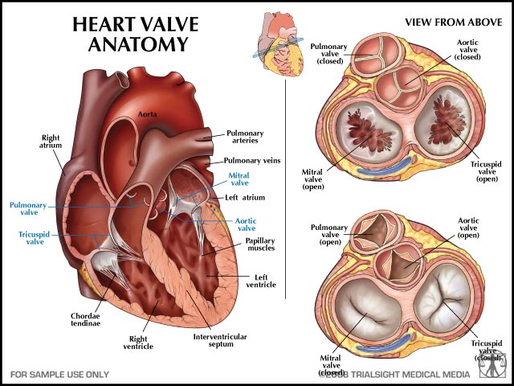
Mammalian Heart
The atrioventricular (AV) valves separate each atrium and ventricle
The semilunar valves control blood flow to the aorta and the pulmonary artery
The “lub-dup” sound of a heart beat is caused by the recoil of blood against the AV valves (lub) then against the semilunar (dup) valves

Slide 9
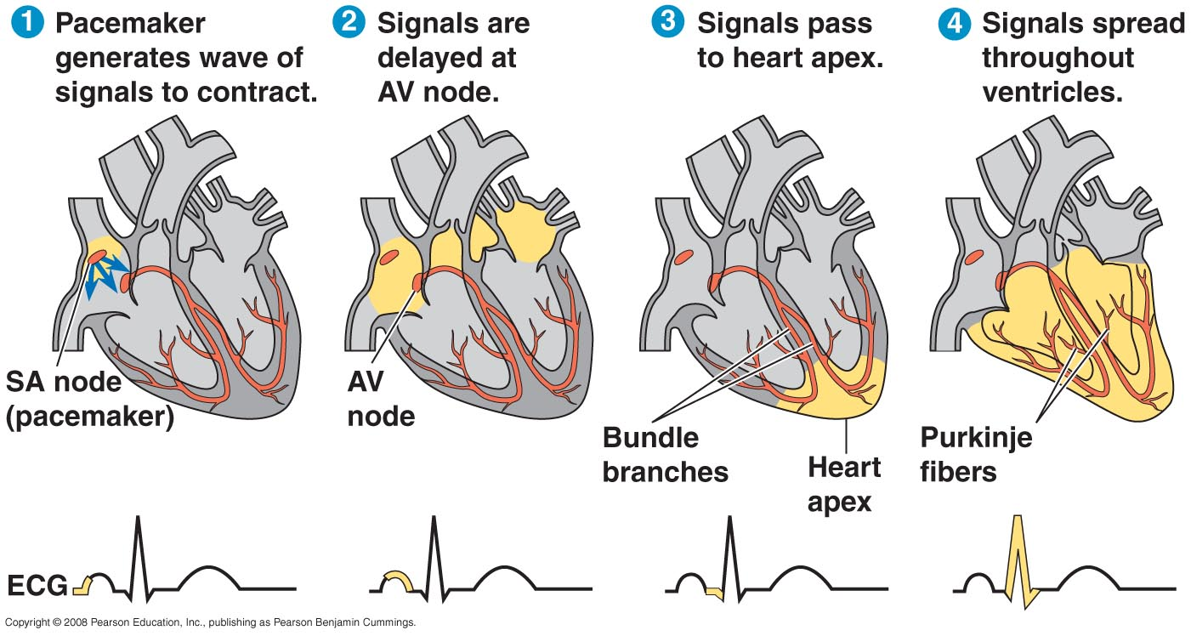
Heart Beat
Some cardiac muscle cells are self-excitable, meaning they contract without any signal from the nervous system
The sinoatrial (SA) node, or pacemaker, sets the rate and timing at which cardiac muscle cells contract
Impulses from the SA node travel to the atrioventricular (AV) node
At the AV node, the impulses are delayed and then travel to the Purkinje fibers that make the ventricles contract
The pacemaker is influenced by nerves, hormones, body temperature, and exercise

Slide 10
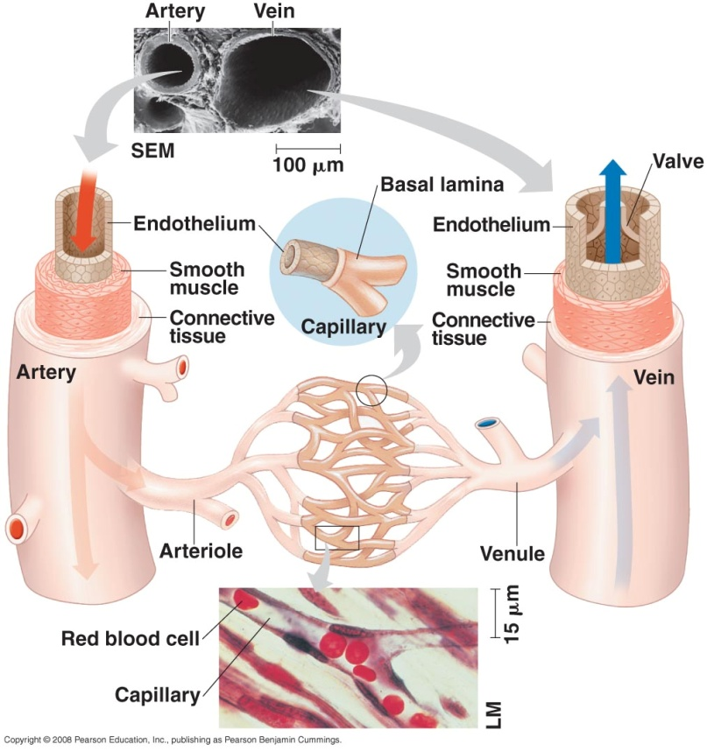
Blood Flow
The epithelial layer that lines blood vessels is called the endothelium
Capillaries have thin walls, the endothelium plus its basement membrane, to facilitate the exchange of materials
Arteries and veins have an endothelium, smooth muscle, and connective tissue
Arteries have thicker walls than veins to accommodate the high pressure of blood pumped from the heart
In the thinner-walled veins, blood flows back to the heart mainly as a result of muscle action

Slide 11
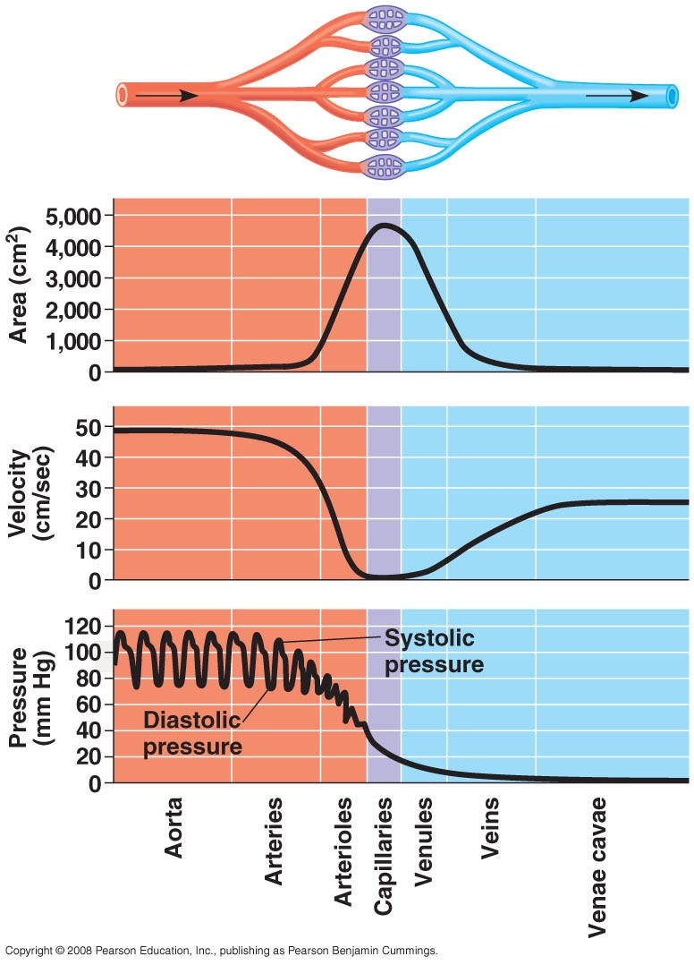
Blood Flow
Physical laws governing movement of fluids through pipes affect blood flow and blood pressure
Velocity of blood flow is slowest in the capillary beds, as a result of the high resistance and large total cross-sectional area
Blood flow in capillaries is necessarily slow for exchange of materials

Slide 12
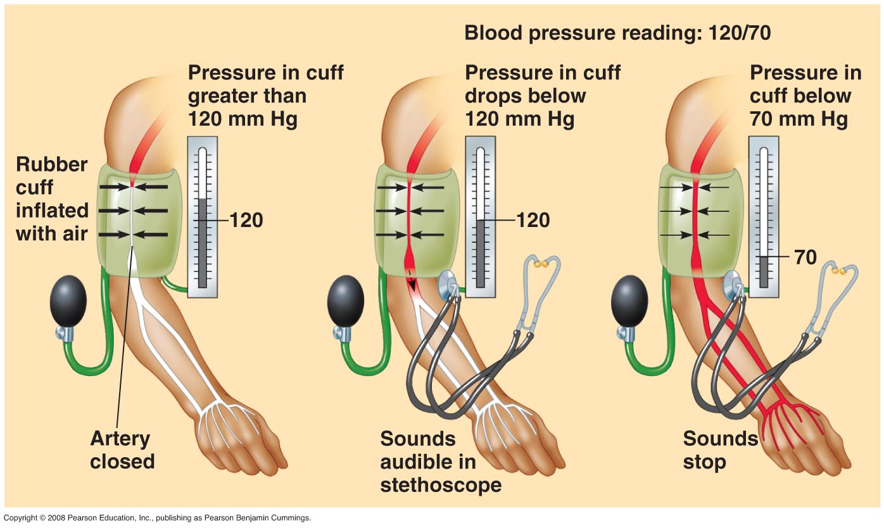
Blood Pressure
Blood pressure is the hydrostatic pressure that blood exerts against the wall of a vessel
In rigid vessels blood pressure is maintained; less rigid vessels deform and blood pressure is lost
Systolic pressure is the pressure in the arteries during ventricular systole; it is the highest pressure in the arteries
Diastolic pressure is the pressure in the arteries during diastole; it is lower than systolic pressure
A pulse is the rhythmic bulging of artery walls with each heartbeat

Slide 13
Vasoconstriction and Vasodialation
Blood pressure is determined by cardiac output and peripheral resistance due to constriction of arterioles
Vasoconstriction is the contraction of smooth muscle in arteriole walls; it increases blood pressure
The peptide endothelin is an important inducer of vasoconstriction
Vasodilation is the relaxation of smooth muscles in the arterioles; it causes blood pressure to fall
Vasoconstriction and vasodilation help maintain adequate blood flow as the body’s demands change

Slide 14
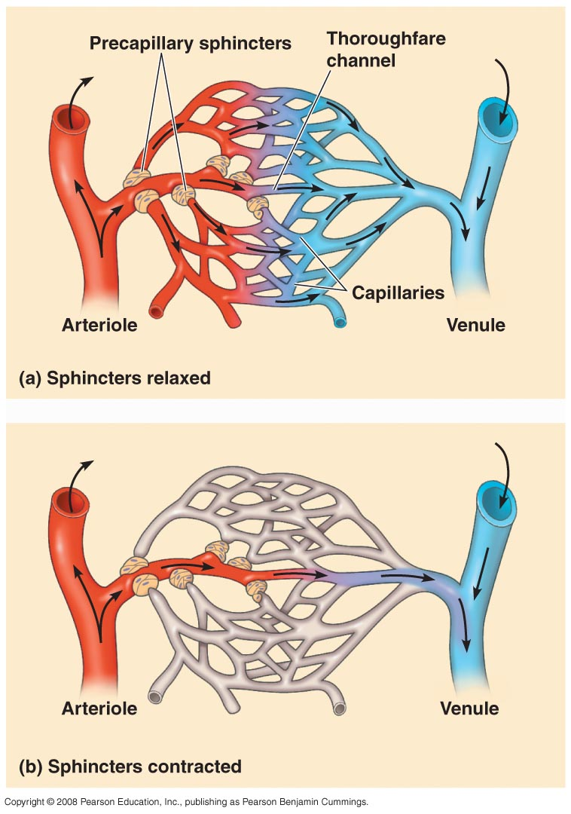
Capillary Function
Capillaries in major organs are usually filled to capacity
Blood supply varies in many other sites
Two mechanisms regulate distribution of blood in capillary beds:
Contraction of the smooth muscle layer in the wall of an arteriole constricts the vessel
Precapillary sphincters control flow of blood between arterioles and venules

Slide 15
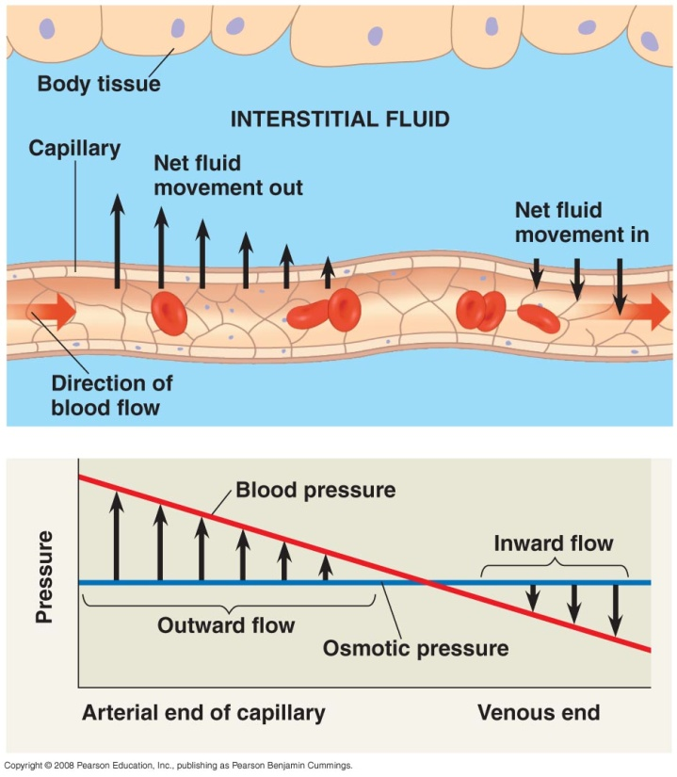
Capillary Function
The critical exchange of substances between the blood and interstitial fluid takes place across the thin endothelial walls of the capillaries
The difference between blood pressure and osmotic pressure drives fluids out of capillaries at the arteriole end and into capillaries at the venule end

Slide 16
Blood
Blood in the circulatory systems of vertebrates is a specialized connective tissue
Blood consists of several kinds of cells suspended in a liquid matrix called plasma
Plasma is 90% water
Another important class of solutes is the plasma proteins, which influence blood pH, osmotic pressure, and viscosity
Various plasma proteins function in lipid transport, immunity, and blood clotting
The cellular elements occupy about 45% of the volume of blood

Slide 17
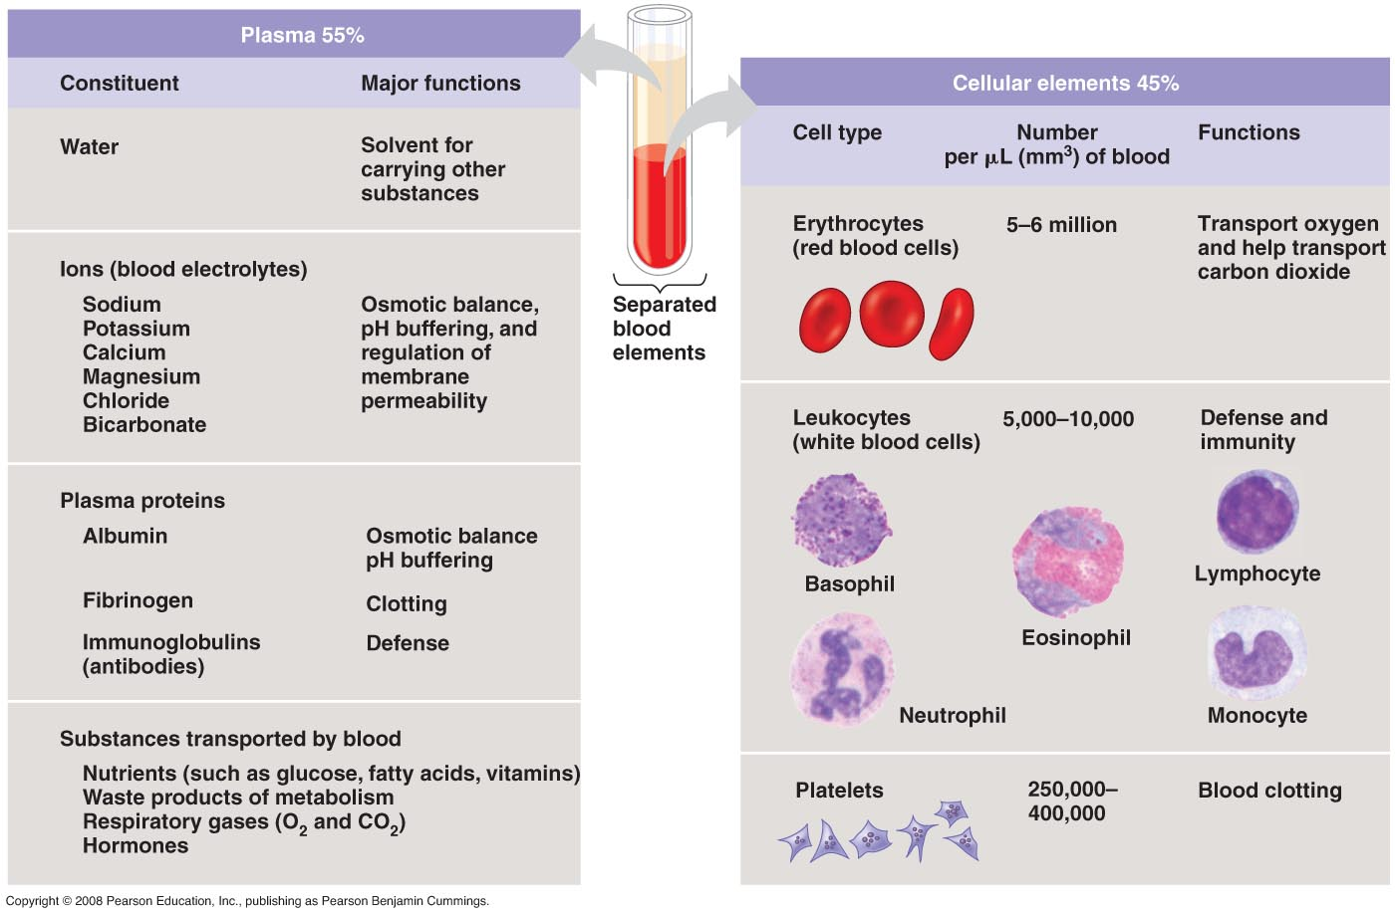
Blood
Suspended in blood plasma are two types of cells:
Red blood cells (erythrocytes) transport oxygen
The most numerous blood cells
They contain hemoglobin, the iron-containing protein that transports oxygen

Slide 18
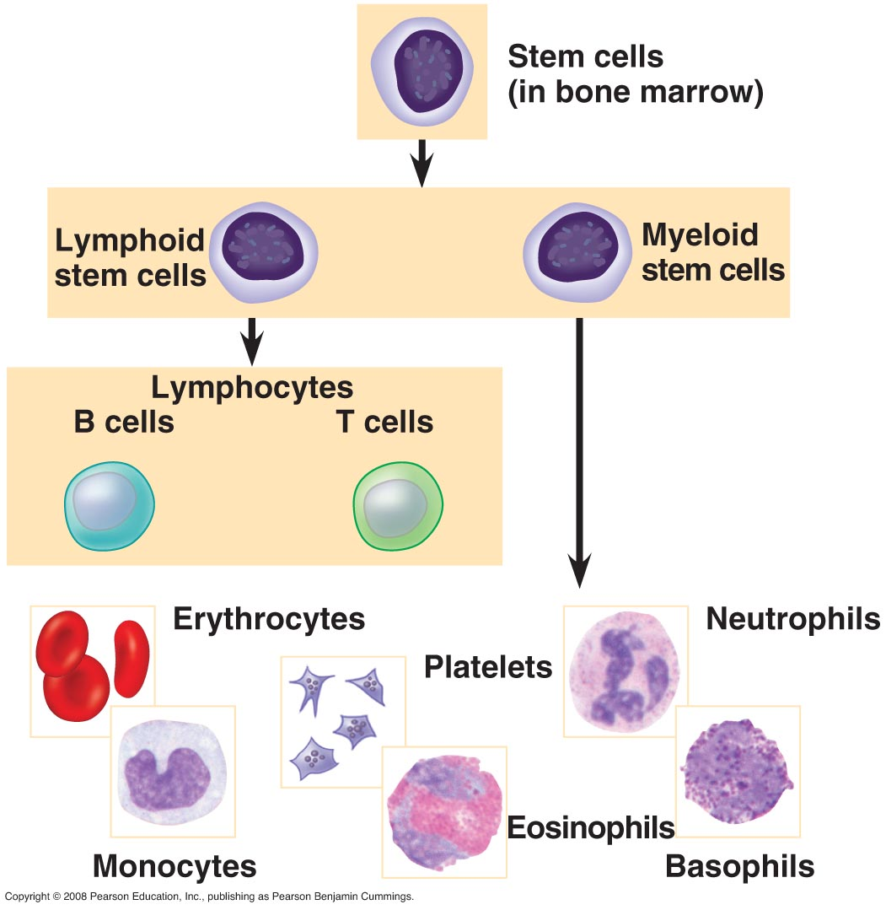
Blood
White blood cells (leukocytes) function in defense
There are five major types of white blood cells, or leukocytes: monocytes, neutrophils, basophils, eosinophils, and lymphocytes
They function in defense by phagocytizing bacteria and debris or by producing antibodies
They are found both in and outside of the circulatory system
Platelets, a third cellular element, are fragments of cells that are involved in clotting

Slide 19
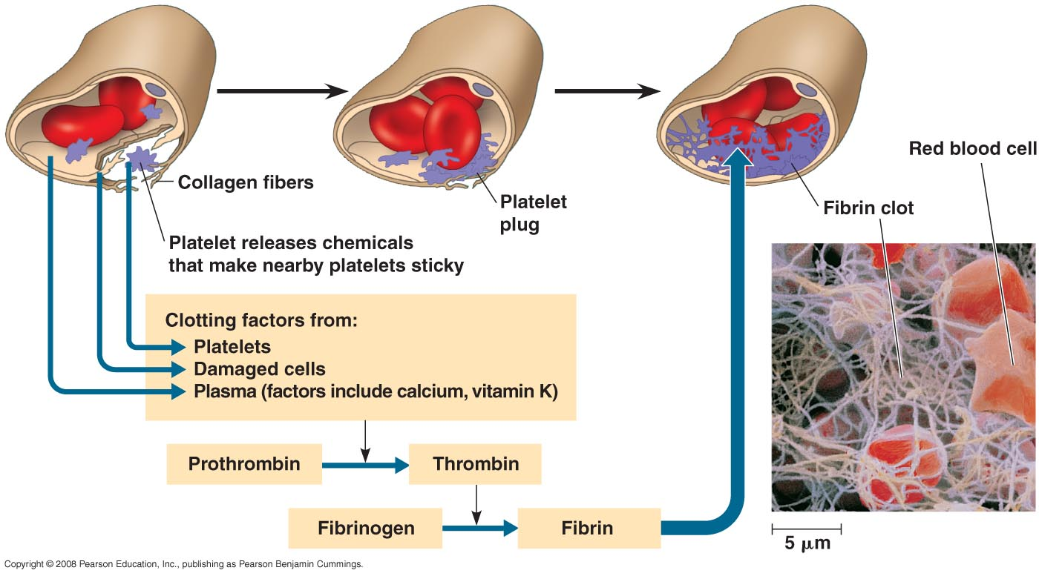
Clotting
When the endothelium of a blood vessel is damaged, the clotting mechanism begins
A cascade of complex reactions converts fibrinogen to fibrin, forming a clot
A blood clot formed within a blood vessel is called a thrombus and can block blood flow

Slide 20
Gas Exchange
Gas exchange supplies oxygen for cellular respiration and disposes of carbon dioxide
Gases diffuse down pressure gradients in the lungs and other organs as a result of differences in partial pressure
Partial pressure is the pressure exerted by a particular gas in a mixture of gases
A gas diffuses from a region of higher partial pressure to a region of lower partial pressure
In the lungs and tissues, O₂ and CO₂ diffuse from where their partial pressures are higher to where they are lower

Slide 21
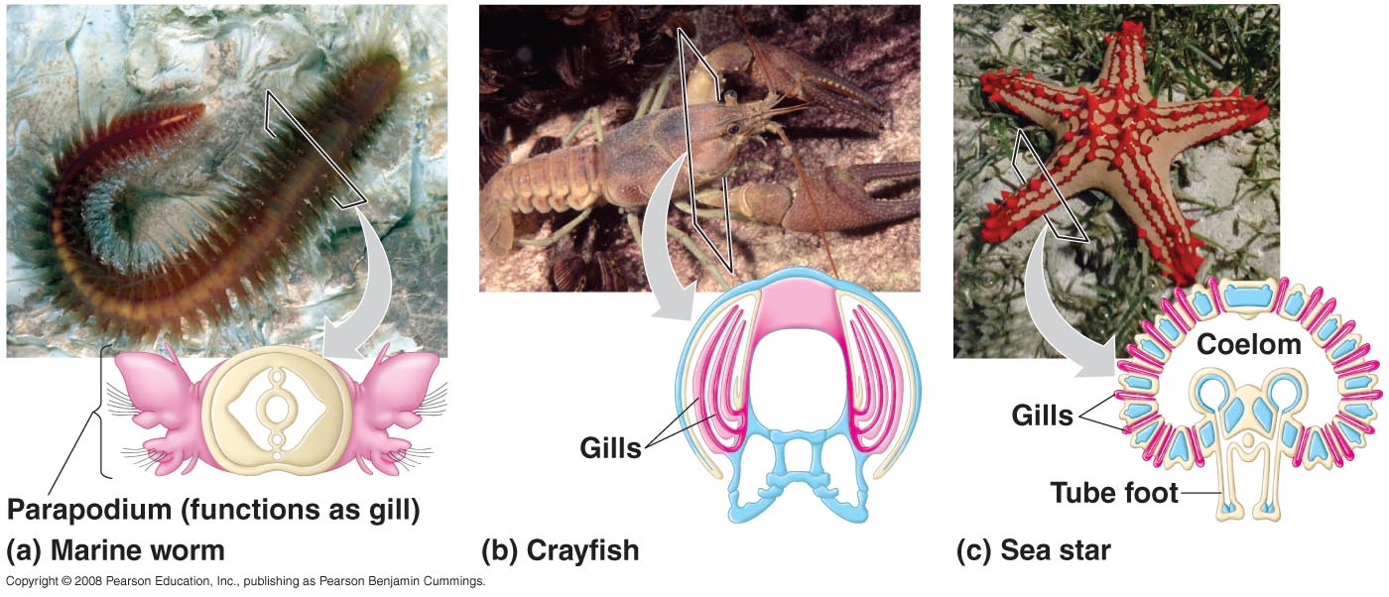
Respiratory Media
Animals can use air or water as a source of O₂, or respiratory medium
In a given volume, there is less O₂ available in water than in air
Obtaining O₂ from water requires greater efficiency than air breathing

Slide 22
Respiration Surfaces
Animals require large, moist respiratory surfaces for exchange of gases between their cells and the respiratory medium, either air or water
Gas exchange across respiratory surfaces takes place by diffusion
Respiratory surfaces vary by animal and can include the outer surface, skin, gills, tracheae, and lungs

Slide 23
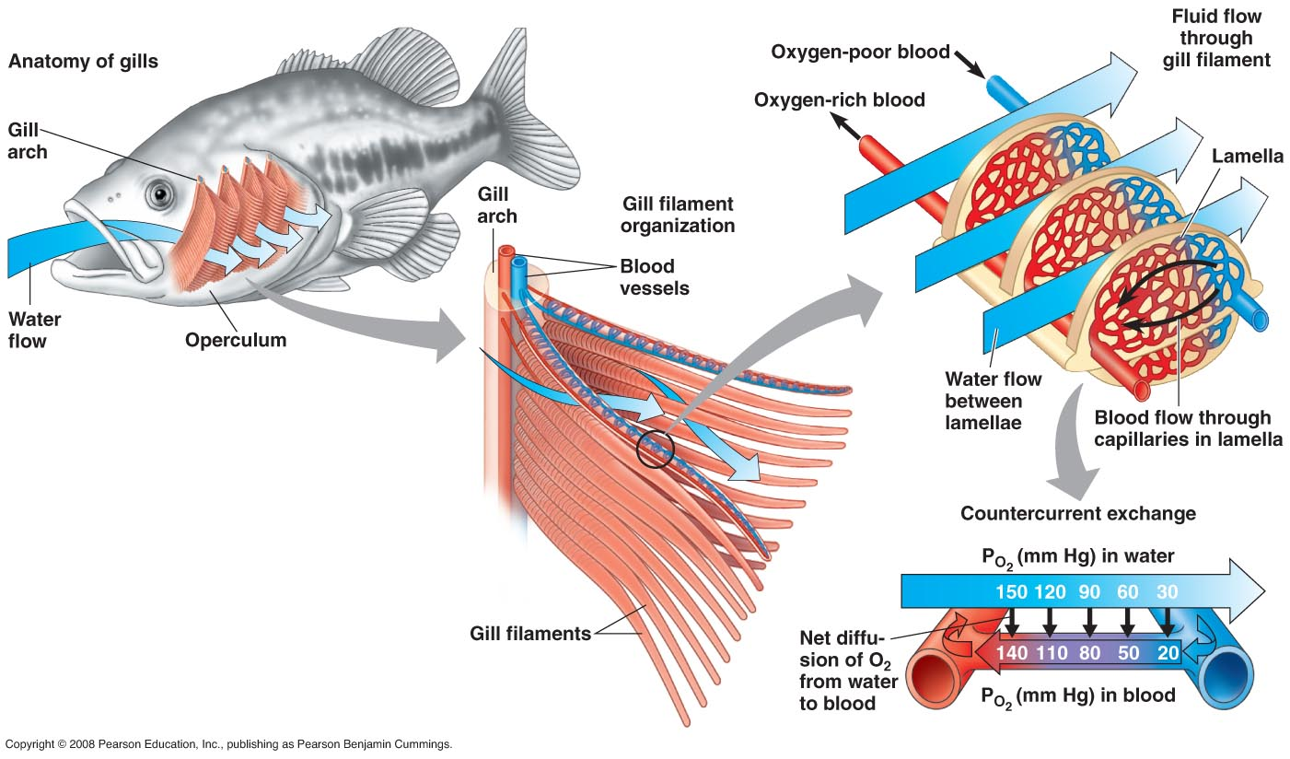
Animal Gas Exchange
Ventilation moves the respiratory medium over the respiratory surface
Aquatic animals move through water or move water over their gills for ventilation
Fish gills use a countercurrent exchange system, where blood flows in the opposite direction to water passing over the gills; blood is always less saturated with O₂ than the water it meets

Slide 24
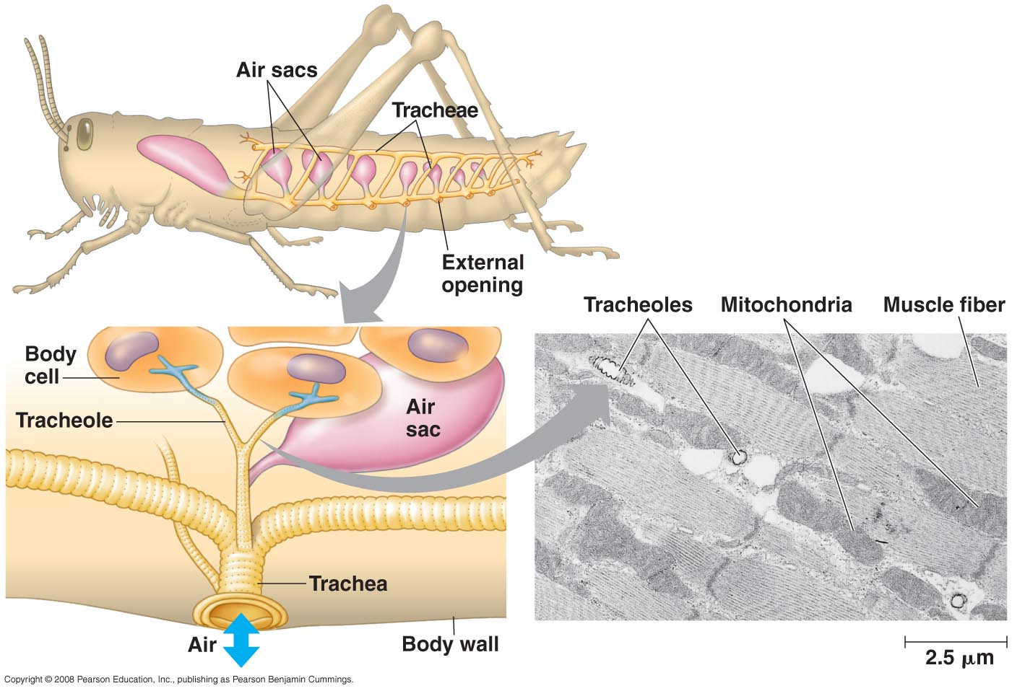
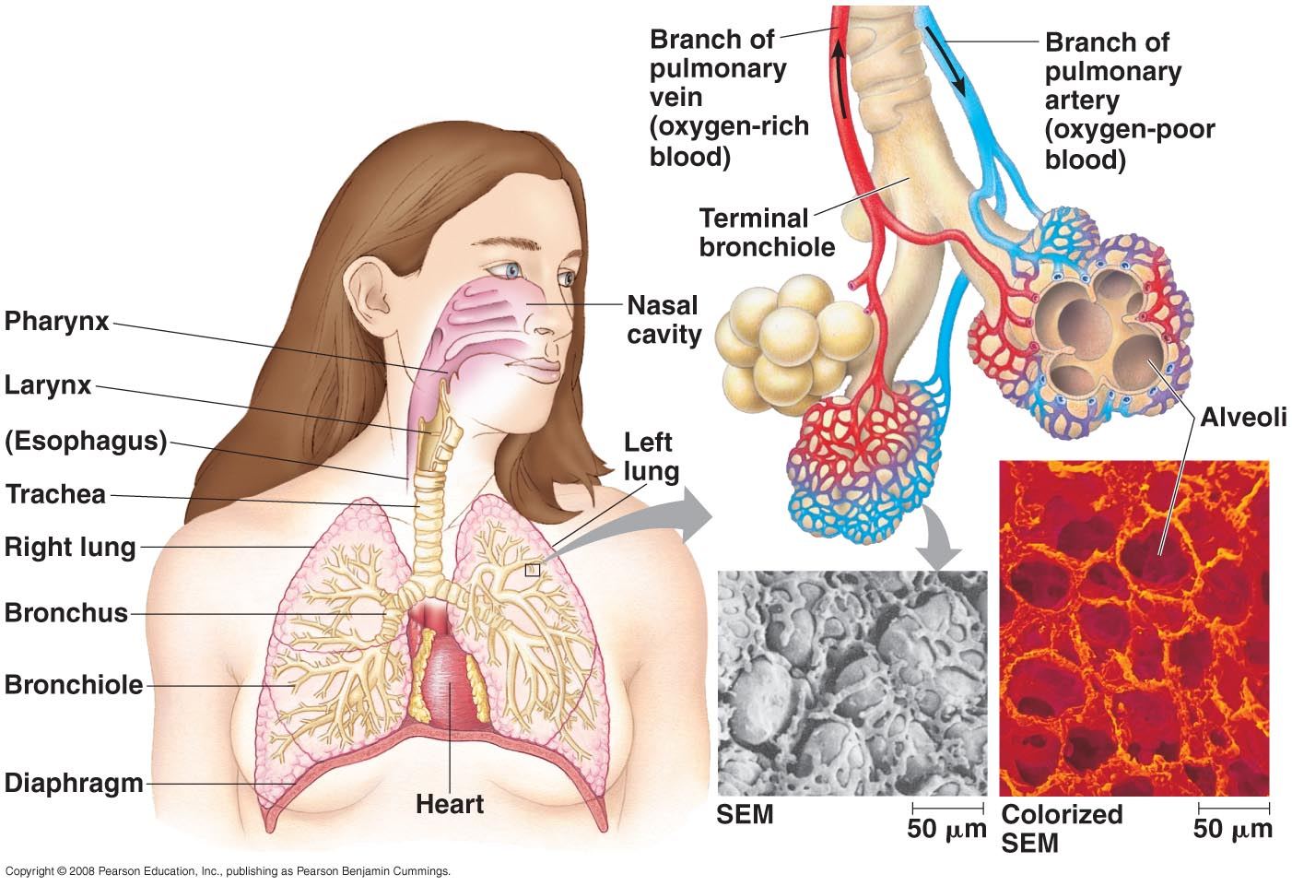
Animal Gas Exchange
The tracheal system of insects consists of tiny branching tubes that penetrate the body and supply O₂ directly to body cells. The respiratory and circulatory systems are separate

Slide 25
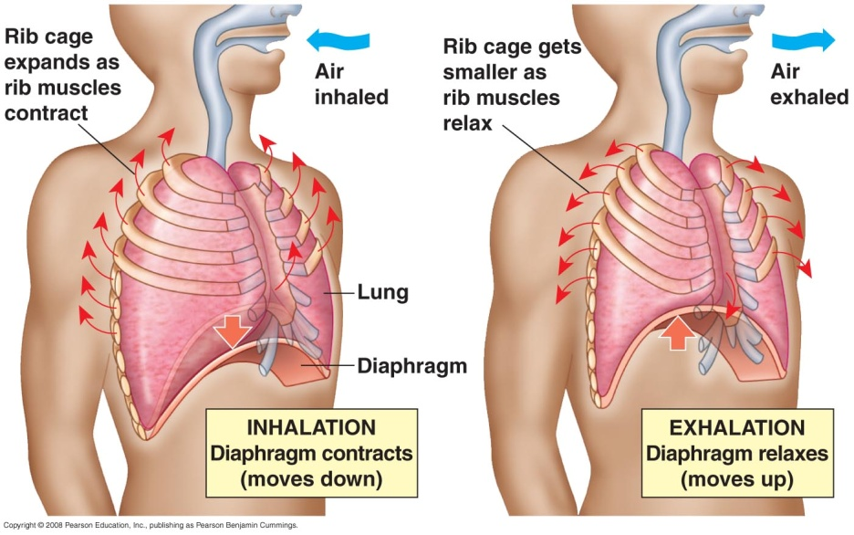
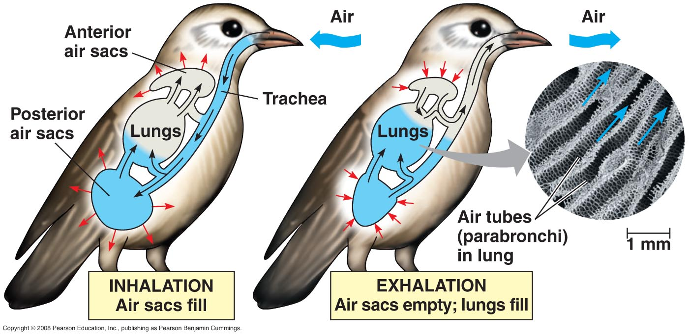
Animal Gas Exchange
Lungs are an infolding of the body surface. The circulatory system transports gases between the lungs and the rest of the body
An amphibian such as a frog ventilates its lungs by positive pressure breathing, which forces air down the trachea
Mammals ventilate their lungs by negative pressure breathing, which pulls air into the lungs

Slide 26
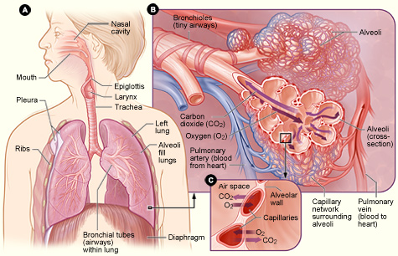
Structure of the Lungs
Each person has 2 lungs (one on right and one on left side of the chest) that receive air from the outside world via the trachea
Air can enter the body from either the nose or mouth
Prior to reaching the lungs, the trachea branches into the left and right bronchi
At the end of each bronchi, each lung is filled with alveoli (air sacs)
This is the location of gas exchange with blood

Slide 27
Alveolar Walls
The walls of each alveoli are surrounded by capillaries
Oxygen will diffuse from the lung to the blood
Carbon dioxide will diffuse from the blood to the lungs
Transport system (blood) is nearby and allows for transport around the body
Remember blood will return to the heart via the pulmonary vein in preparation of movement around the body

Slide 28
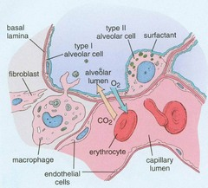
Alveolar Walls
Alveoli and capillaries are very thin, each is only 1 cell thick
Type 1 Pneumocytes: site of gas exchange (~95% of alveoli cells)
Type 2 Pneumocytes: secretes fluid which coats the inner surface of the alveoli
Makes the lungs moist which helps the efficiency of gas exchange
Pulmonary surfactant in the fluid helps to prevent the lung from collapsing by reducing surface tension
www.lookingfordiagnoses.com

Slide 29
Breathing
In order to breath, your thorax must continue moving
Thorax is made larger to suck in air and made smaller to squeeze air out.
There are 2 sets of muscles to help with this process
Intercostal muscles – located between the ribs
Diaphragm – sheet of muscle and elastic tissue located beneath the lungs and heart (spans the body)

Slide 30
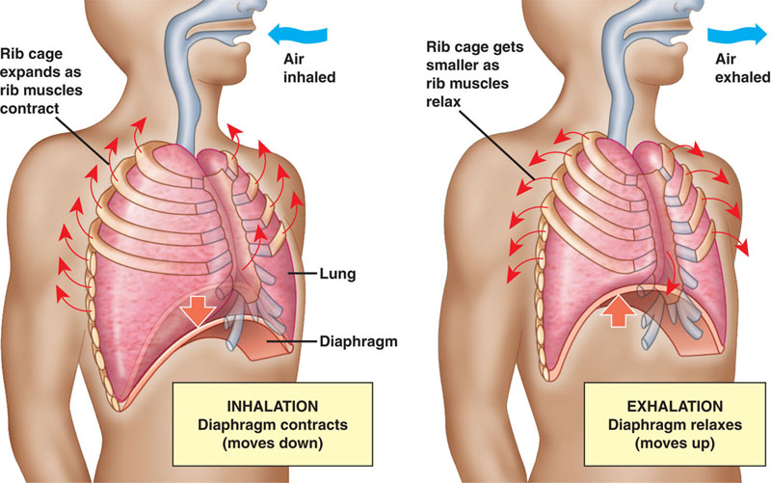
Breathing
Breathing in or inspiration
The muscles of the diaphragm contract, pulling the diaphragm downwards, increasing the volume of the thorax
The external intercostal muscles also contract, pulling the rib cage upwards, increasing volume of the thorax

Slide 31
Breathing
Breathing out or expiration
The muscles of the diaphragm relax, creating a dome shape, decreasing the thorax volume
The external intercostal muscles relax, dropping the rib cage into the normal position, decreasing the thorax volume
If breathing out forcefully (or coughing), the internal intercostal muscles will contract , dropping the rib cage more
As the volume decreases, the pressure inside the lungs increase. This causes the air inside to be pushed out.

