Slide 1
Electron Microscope Simulation
This activity is a simulation of views of cells from an electron microscope.
Click images in the blue box to change slide.
Click x4000 buttons to increase magnification.
© David Faure, InThinking www.biology-inthinking.co.uk

Slide 2
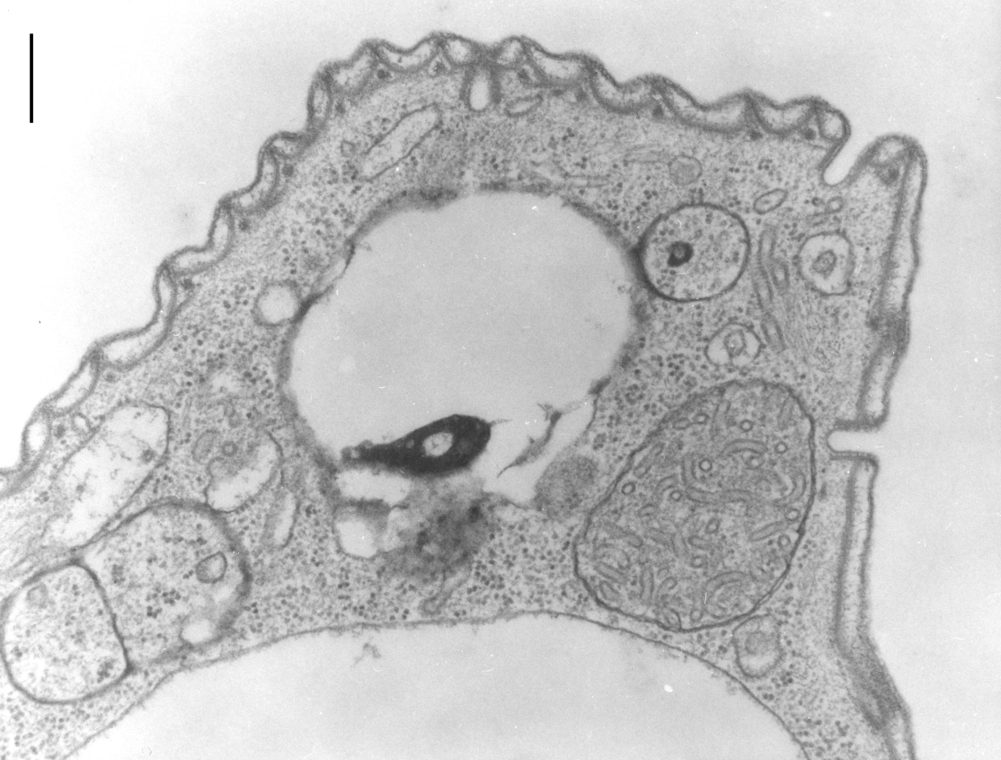
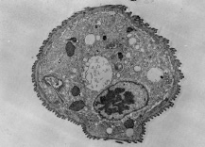
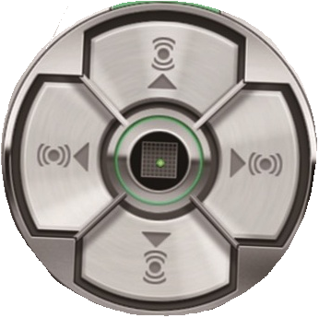
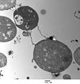
Electron Microscope Terminal - New York Aquarium
A
∅
⊗
B
C
D
x4000
x10000
E
x40000
x100000

Slide 3
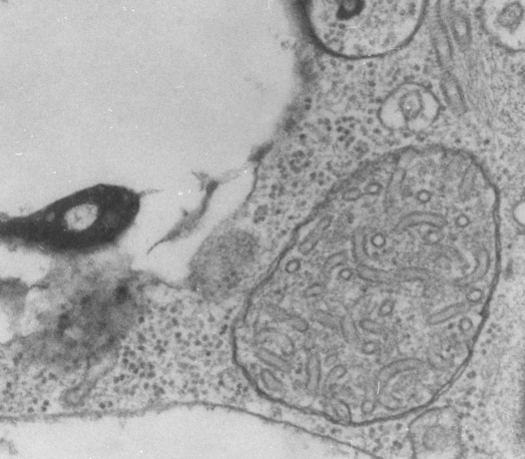
Electron Microscope Terminal - New York Aquarium
A
∅
⊗
B
C
D
x4000
x10000
E
x40000
x100000

Slide 4
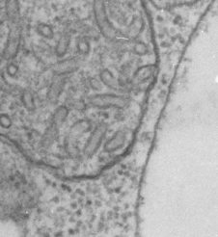
Electron Microscope Terminal - New York Aquarium
A
∅
⊗
B
C
D
x4000
x10000
E
x40000
x100000

Slide 5
Electron Microscope Terminal - New York Aquarium
A
∅
⊗
B
C
D
x4000
x10000
E
x40000
x100000

Slide 6
Electron Microscope Terminal - New York Aquarium
A
∅
⊗
B
C
D
x4000
x10000
E
x40000
x100000

Slide 7
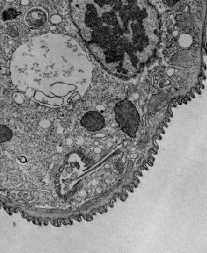
Electron Microscope Terminal - New York Aquarium
A
∅
⊗
B
C
D
x4000
x10000
E
x40000
x100000

Slide 8
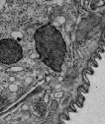
Electron Microscope Terminal - New York Aquarium
A
∅
⊗
B
C
D
x4000
x10000
E
x40000
x100000

Slide 9
Electron Microscope Terminal - New York Aquarium
A
∅
⊗
B
C
D
x4000
x10000
E
x40000
x100000

Slide 10
Electron Microscope Terminal - New York Aquarium
A
∅
⊗
B
C
D
x4000
x10000
E
x40000
x100000

Slide 11
Electron Microscope Terminal - New York Aquarium
A
∅
⊗
B
C
D
x4000
x10000
E
x40000
x100000

Slide 12
Electron Microscope Terminal - New York Aquarium
A
∅
⊗
B
C
D
x4000
x10000
E
x40000
x100000

Slide 13
Electron Microscope Terminal - New York Aquarium
A
∅
⊗
B
C
D
x4000
x10000
E
x40000
x100000

Slide 14
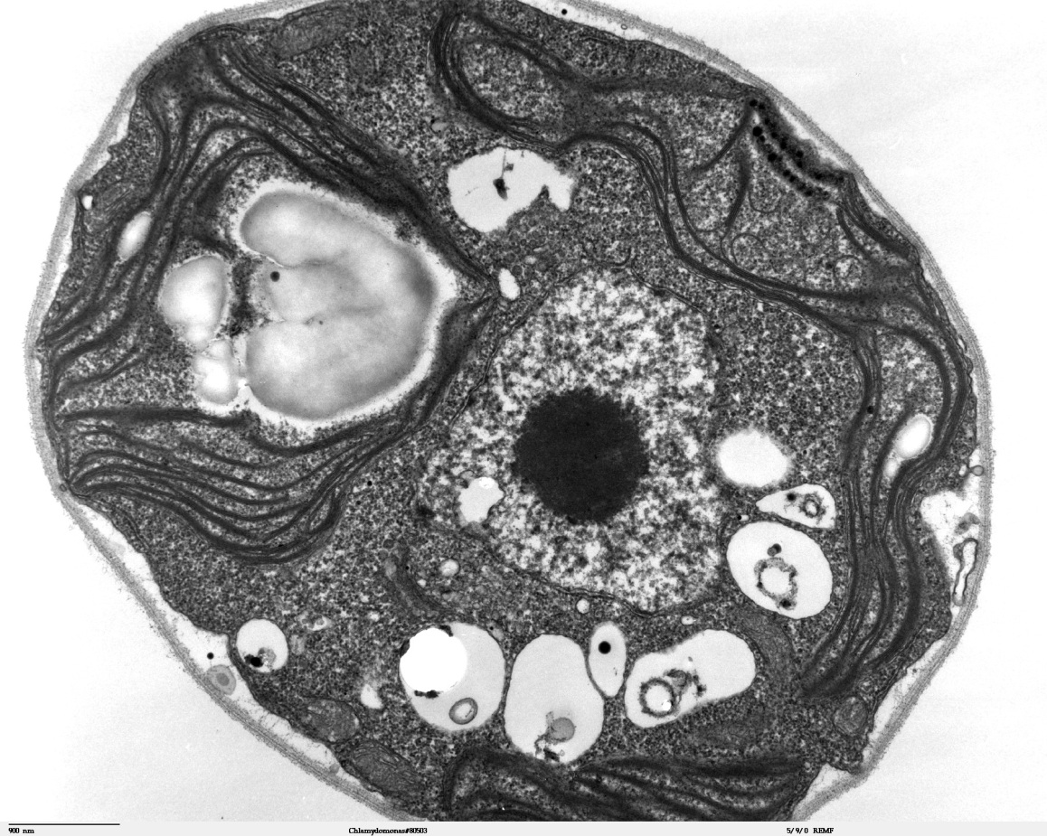
Electron Microscope Terminal - New York Aquarium
A
∅
⊗
B
C
D
x4000
x10000
E
x40000
x100000

Slide 15
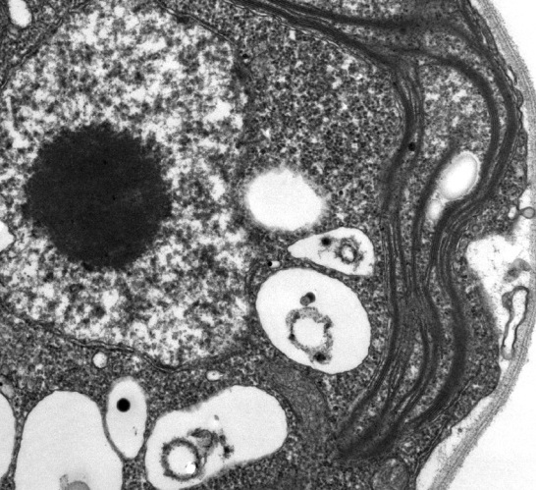
Electron Microscope Terminal - New York Aquarium
A
∅
⊗
B
C
D
x4000
x10000
E
x40000
x100000

Slide 16
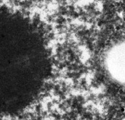
Electron Microscope Terminal - New York Aquarium
A
∅
⊗
B
C
D
x4000
x10000
E
x40000
x100000

Slide 17
Electron Microscope Terminal - New York Aquarium
A
∅
⊗
B
C
D
x4000
x10000
E
x40000
x100000

Slide 18
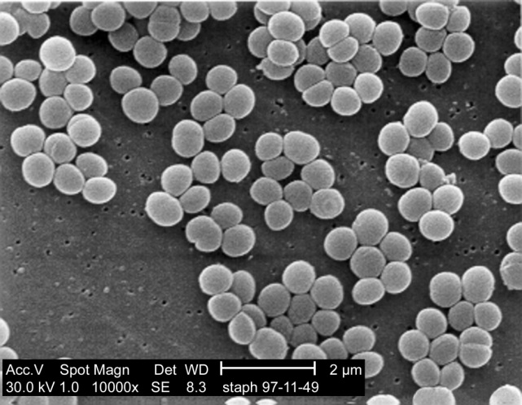
Electron Microscope Terminal - New York Aquarium
A
∅
⊗
B
C
D
x4000
x10000
E
x40000
x100000

Slide 19
Electron Microscope Terminal - New York Aquarium
A
∅
⊗
B
C
D
x4000
x10000
E
x40000
x100000

Slide 20
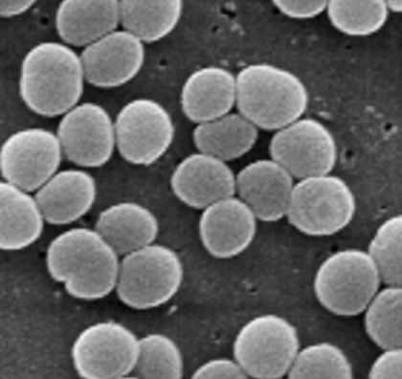
Electron Microscope Terminal - New York Aquarium
A
∅
⊗
B
C
D
x4000
x10000
E
x40000
x100000

Slide 21
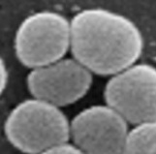
Electron Microscope Terminal - New York Aquarium
A
∅
⊗
B
C
D
x4000
x10000
E
x40000
x100000

